Slide 1
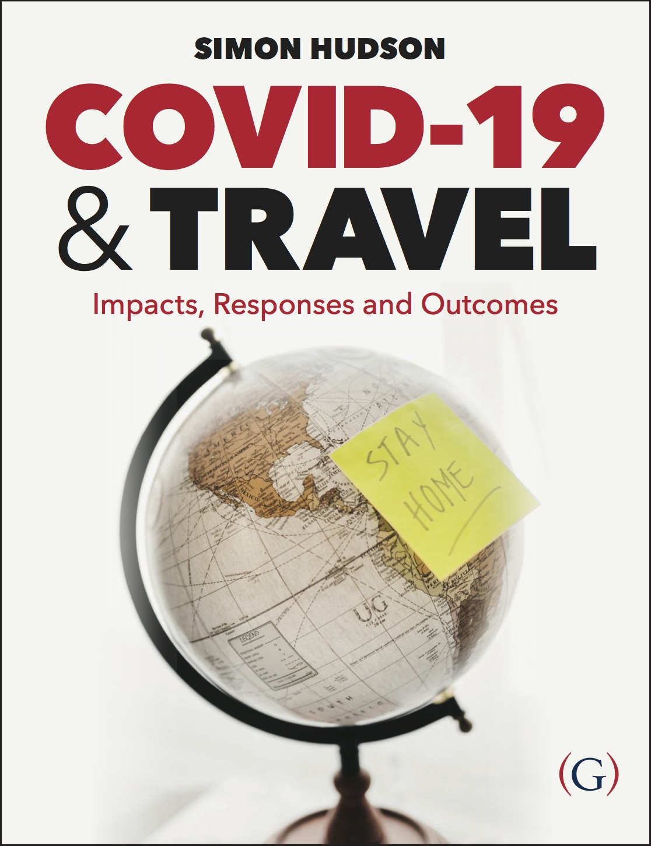
Chapter 6: The future of travel

Slide 2
Topics Covered
Case Study: Vietnam paving the way to the future
The future for the different sectors of the travel industry
COVID-aptability
The servicescape redesigned
Lessons learned
Case Study: Surviving the ‘new normal’

Slide 3
Case Study: Vietnam paving the way to the future
Vietnam’s approach of a national social distancing campaign that shut down non-essential businesses allowed life in the country to return to almost normalcy.
A Steering Committee on COVID-19 Prevention and Control communicated transparently with the public through daily text messages, frequent articles in the media, street banners, and a website.
Before opening its international borders, Vietnam had to stimulate domestic tourism, incentivized by discounted trips for internal travelers.
Vietnam worked with bordering countries to promote inter-regional travel.

Slide 4
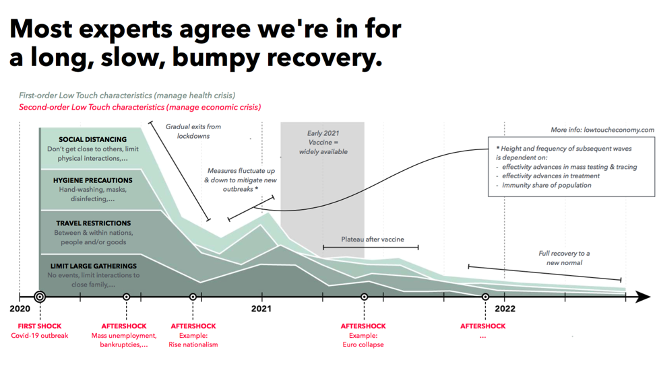

Slide 5
The future for the different sectors of the travel industry - airlines
More than 70 different areas in the airline passenger journey are expected to change or be introduced from scratch.
The federal government’s help is needed to screen customers in making sure passengers are safe and healthy enough to board a plane.
Emirates was the first airline to conduct on-site rapid COVID-19 tests for passengers, which would give results within 10 minutes.
Some facilities began using thermal cameras for temperature screening.
Passengers may need proof of vaccine to travel internationally.

Slide 6
The future for the different sectors of the travel industry - cruise ships
New sanitation procedures, the elimination of self-service, new health requirements for passengers over 70, full crew training, and emergency procedures will be put in place to prepare for traveling by cruise ship again.
Cruise ships are likely to embrace technology at a faster pace post COVID-19.
In 2014, Royal Caribbean introduced a ‘Bionic Bar’ to one ship in which two robots could mix drinks for passengers, a low-touch innovation being useful for new health protocols on cruise ships.

Slide 7
The future for the different sectors of the travel industry - destinations
‘Air bridges’ or ‘travel bubbles’ were created to make travel exclusive within a zone of two or three countries.
Travel bubbles strategically allow visitors from neighboring countries whose travelers account for much of a nation’s tourism receipts.

Slide 8
The future for the different sectors of the travel industry - destinations
Rather than bubbles, other destinations chose to open their international borders for tourist from low-risk countries only.
Collaborative marketing efforts also played a role in kickstarting tourism after the pandemic.
Measures were taken worldwide to convince international travelers they were safe, and some destinations created quality standards for reassurance.

Slide 9
The future for the different sectors of the travel industry - destinations
For destinations seeking guidance on recovery after the pandemic, the UNWTO designed a COVID-19 Tourism Recovery Technical Assistance Package for both public and private stakeholders in their crisis response.
The UNWTO package outlines the range of technical assistance and details potential areas of intervention.
Economic recovery, marketing and promotion, and institutional strengthening were the main pillars in the package’s design.

Slide 10
The future for the different sectors of the travel industry - accommodations
Some hotels themselves went beyond guidelines for health and safety and introduced unique cleaning programs for their properties.
Technology played an important role in cleaning and guest experience under new protocols.
Communication was especially important to keep stakeholders informed and facilitate guest and staff safety.

Slide 11
The future for the different sectors of the travel industry - attractions
Temperature checks and masks were common in the attractions sector to help prevent the spread of COVID-19 where crowding was likely to happen.
Technology was used to send out a signal if people got too close to each other in crowds.

Slide 12
The future for the different sectors of the travel industry - attractions
Holovis, a leading experience designer, developed a new social distancing app for attractions called Crowd Solo.
Guests could utilize the app as a way of booking attractions and viewing heat-map data in real time to show attraction operators where action is needed to disperse any hotspots.

Slide 13
The future for the different sectors of the travel industry - events
Business and professional online events increased 1,100% in April 2020 compared to April 2019.
Online events are expected to continue playing a big role in events post-pandemic.
Combined virtual and in-person experiences avoid having thousands of people congregate in one space at a time.
Some people in the events sector are concerned with not being able to provide the same level of expertise with virtual events.

Slide 14
The future for the different sectors of the travel industry - events
Fan-less concerts with broadcasts and reduced-capacity shows were the main focuses in restarting events post-pandemic.
Drive-in concerts were also seeing success as ways to host live performances to large crowds while maintaining social distance.

Slide 15
COVID-aptability
The ability to adapt to changing consumer demands and behavior is a competitive advantage in business.
For example, EmiControls, a world leader in snowmaking technology, used similar technology to satisfy a growing need for disinfection.
A disinfection tunnel allowed people to disinfect themselves from head to toe, and has been useful at attractions, airports and hotels in the travel sector.

Slide 16
COVID-aptability
There are short, medium, and long-term strategies that the industry can adopt to mitigate the impacts of COVID-19.
In the short-term, organizations may look for substitute products and services to satisfy new demand.
Businesses can survive by focusing on recovering revenue, rebuilding operations, rethinking organization, and adopting digital solutions.

Slide 17
COVID-aptability

Slide 18
The servicescape redesigned
The environment in which a service is delivered is often referred to as the ‘servicescape’.
COVID-19 impacts caused destinations and businesses to make public spaces more functional and more attractive than they were before lockdown to allow for socially distant gatherings.
There was a barrier to redesigning because of criticism, with some solutions being based on defensive design principles such as plastic screens.
Open kitchens became a growing trend while customers expressed desire to see their food being made.
In hotels, there may be fewer carpeted areas, and the use of tiles and stones may increase for flooring design.

Slide 19
Lessons learned
Tourism is an important industry not to be taken for granted.
Strong leadership is required to deal with a crisis.
Communicating during a crisis is critical.
Travelers may change – forever.
The future will be technology-driven.

Slide 20
Case Study: Surviving the ‘new normal’
Opening restaurants again after lockdown was just like starting from scratch, with drastic changes made to meet new industry regulations.
Menus would be access via QR codes, a concept which was unfamiliar to the fine dining restaurant style.
Some financial support was given from governments during the crisis.

Slide 21
Video Links
Lockdown – BBC Travel show – very good – covers various topics including VR and vloggers → https://www.youtube.com/watch?v=xNjehC9Fp_g
Future of travel after the pandemic → https://www.youtube.com/watch?v=hjDUEYIiZNM
Kempinski Hotel new safety protocol → https://www.youtube.com/watch?v=skowssMKqM0
Global News – the future of travel → https://www.youtube.com/watch?v=LTMILJX_oCU
Club Med Safe Together initiatives → https://www.youtube.com/watch?v=m1v61VnRKbA&feature=youtu.be
Mekong – for Vietnam case → https://www.youtube.com/watch?v=5JYiatEbzzU
Future of Travel → https://www.quo-global.com/podcasts/
"Rise of Sanitized Travel" Shashank Nigam CEO Simpliflying.com on CBS - TalkingBusiness → https://www.youtube.com/watch?v=jvOMNT-nj1A
Southwest Airlines CEO Gary Kelly says it’s safe to fly → https://www.youtube.com/watch?v=0i5ve3wQKkI
Businesses hope thermal imaging cameras will be key to safe reopening → https://www.youtube.com/watch?v=ggzmjoBw_lU
Bionic Bar! Robotic Bartenders Mix Drinks on Quantum of the Seas – Royal Caribbean → https://www.youtube.com/watch?v=TBF7EE2xnN4
Australia, New Zealand Discuss Travel Bubble → https://www.youtube.com/watch?v=J3XsniHoRWk
Baltic states open Europe’s first corona pandemic ‘travel bubble’ as restrictions ease (ABC News) → https://www.youtube.com/watch?v=7z58cdaavho
UNWTO Launches Global Guidelines to Reopen Tourism → https://www.youtube.com/watch?v=aJG_kv4vDm0
Walt Disney World Resort Theme Parks Prepare for Their Phased Reopening this Weekend → https://www.youtube.com/watch?v=k3ynRXi7N7I
Mads Langer Drive In Concert → https://www.youtube.com/watch?v=Wstt4Cpt-s8
EmiControls presents the "Disinfection Tunnel" → https://www.youtube.com/watch?v=47BJynHu800

